Slide 1
Ensemble Voting – Machine Learning’s Biggest Heroes United
Unlike Bagging/Boosting, where similar types of multiple classifiers are used for majority voting, a voting classifier allows us to combine predictions from multiple machine learning algorithms of various types by majority voting.
To begin, you can use your training dataset to build multiple stand-alone models. When asked to make predictions for new data, a voting classifier can be used to wrap the models and average the predictions of the submodels. Sub-model predictions can be weighted, but manually or heuristically determining the weights for classifiers is difficult. Advanced methods can learn how to best weight the predictions from sub-models, but this is referred to as stacking (stacked aggregation) and is not currently available in scikit-learn.
Let's construct individual models on the Pima diabetes dataset and use the voting classifier to compare the shift in accuracy.

Slide 2
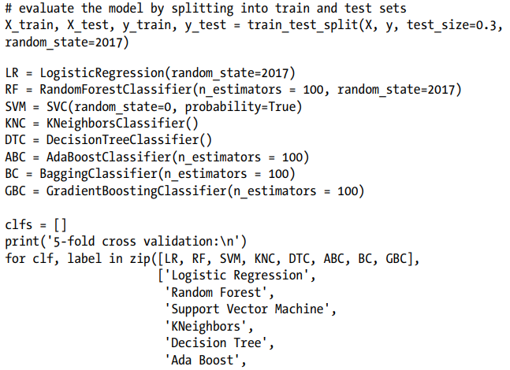

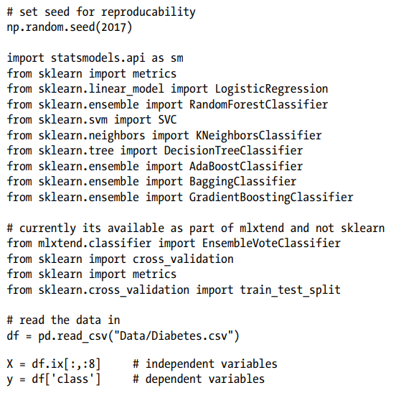
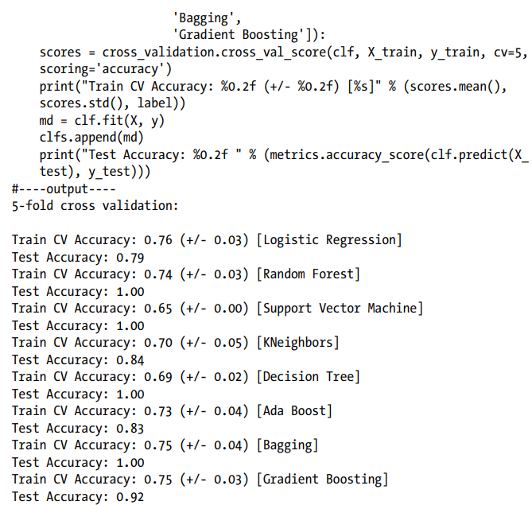
Ensemble model

Slide 3
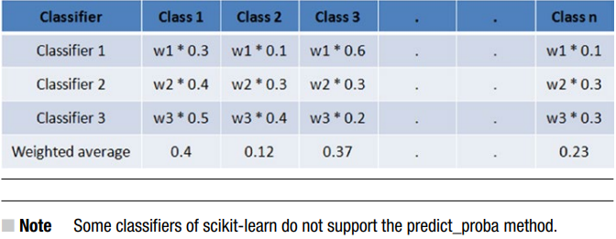
Hard Voting vs. Soft Voting
Hard voting is another name for majority voting. Soft voting is the argmax of the number of expected probabilities. The parameter ‘weights' can be used to give classifiers individual weights. Each classifier's expected class probabilities are multiplied by the classifier weight and summed. The highest average likelihood class label is then used to generate the final class label.

Slide 4
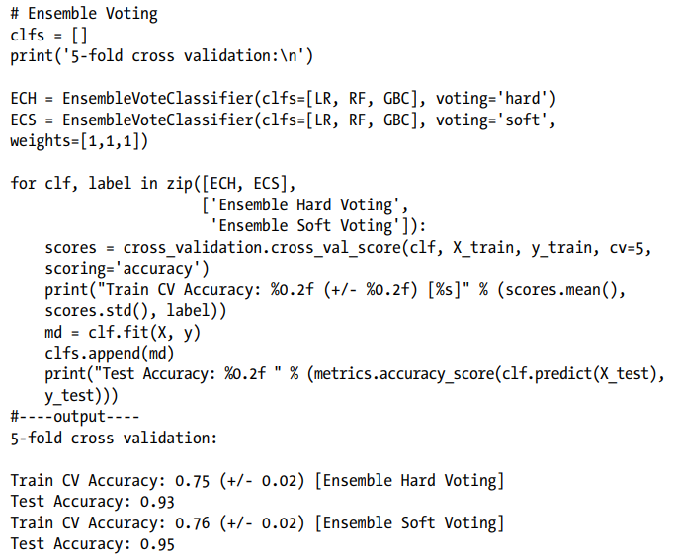

Slide 5
Stacking
In his publication with the journal Neural Networks in 1992, Wolpert David H introduced the principle of stacked generalization, more commonly known as "stacking." Stacking involves training several base models of various types on training and test datasets. Mixing models that function in various ways (kNN, bagging, boosting, etc.) is desirable so that it can learn a portion of the problem. At level 1, use the expected values from base models as features and train a model known as a meta-model, which improves accuracy by integrating the learning of individual models. This is a basic level 1 stacking, and you can stack several levels of various types of models in the same way.

Slide 6
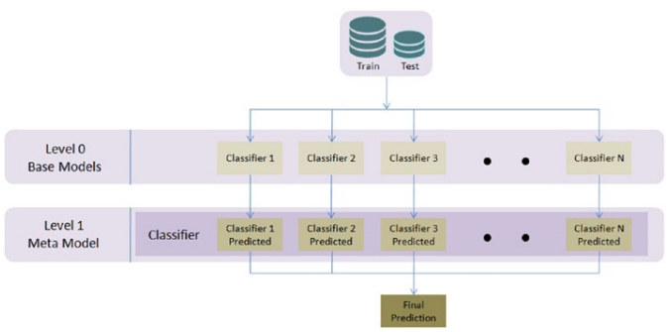

Slide 7
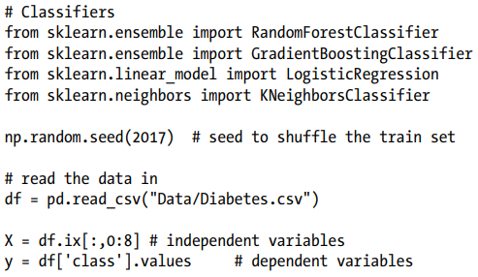
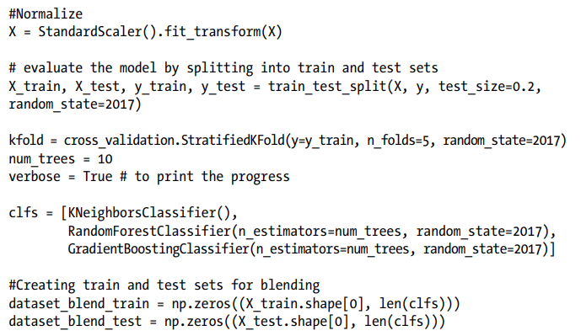

Slide 8
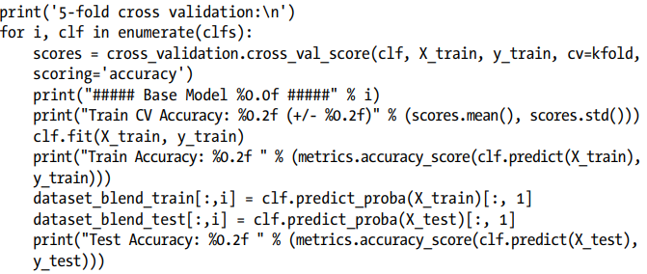
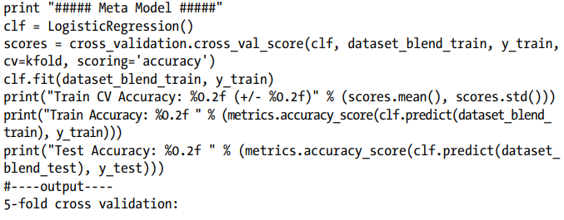

Slide 9
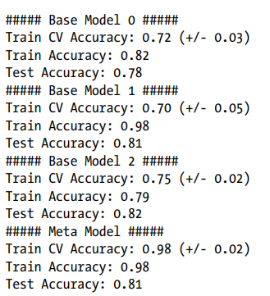

Slide 10
Hyperparameter Tuning
Improving the output score based on data trends and observed evidence is one of the key goals and challenges in the machine learning process. To achieve this goal, almost all machine learning algorithms require the estimation of a particular set of parameters from the dataset in order to optimize the output score. Assume that these parameters are knobs that must be adjusted to various values in order to find the right combination of parameters for the best model accuracy. The easiest way to select a good hyperparameter is to try all possible combinations of parameter values by trial and error. GridSearchCV and RandomSearchCV functions in Scikit-learn allow for an automated and repeatable approach to hyperparameter tuning.

Slide 11
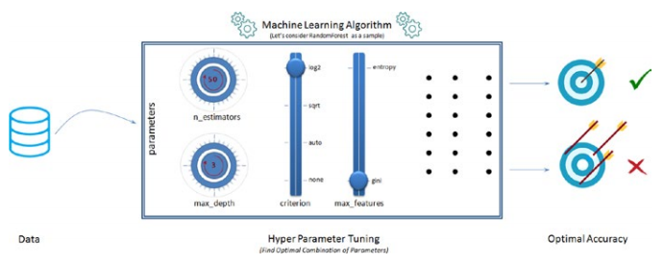

Slide 12
GridSearch
You can specify a collection of parameter values that you'd like to try for a given model. Models are then constructed for all possible combinations of a preset list of hyperparameter values given by you, using scikit-GridSearchCV learn's feature, and the best combination is chosen based on the cross-validation score. GridSearchCV has two drawbacks that you should be aware of.
1. GridSearch is computationally expensive: With more parameter values, it is clear that GridSearch would be computationally expensive. Consider the following scenario: you have five parameters and you want to try five different values for each of them, resulting in 5**5 = 3125 possible combinations.

Slide 13
2. Near-optimal but not ideal parameters: Grid Search will look at the fixed points you have for the numerical parameters, so there's a good chance you'll miss the optimal point that lies between them. For example, suppose you want to try the fixed points for ‘n estimators': [100, 250, 500, 750, 1000] for a decision tree model; there's a possibility the optimal point lies somewhere between the two fixed points, but GridSearch isn't built to search between fixed points.

Slide 14
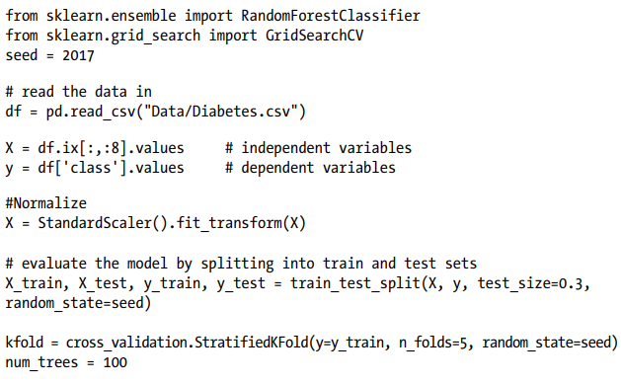
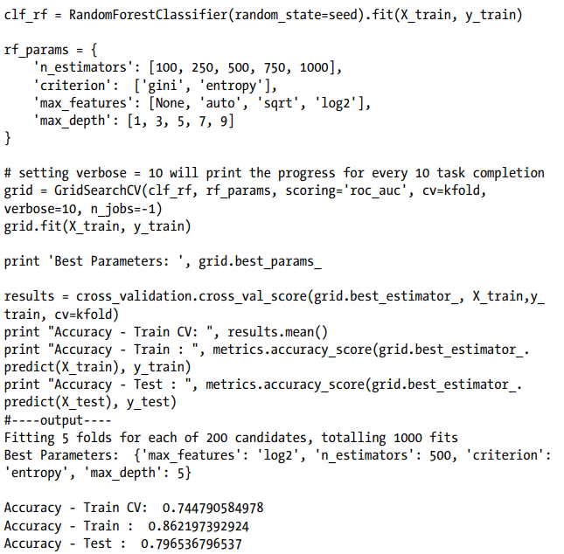

Slide 15
RandomSearch
The RandomSearch algorithm, as its name implies, seeks random combinations of a set of parameters' values. A number of numerical parameters may be defined (unlike fixed values in GridSearch). You have complete control over the amount of random search iterations you want to run. When compared to GridSearch, it is known to find a really good combination in a lot less time. However, you must carefully choose the parameter range and the number of random search iterations, as fewer iterations or smaller ranges can result in missing the best parameter combination.
Let's try RandomSearchCV with the same parameters as GridSearch to see how fast and accurate it is.

Slide 16
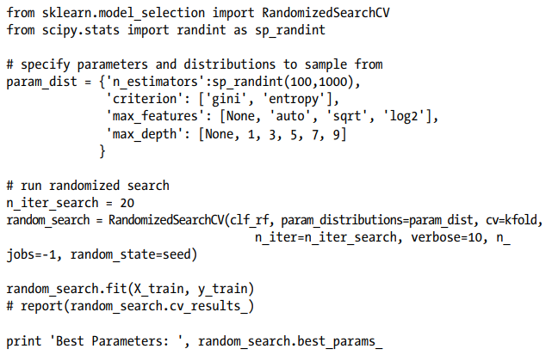
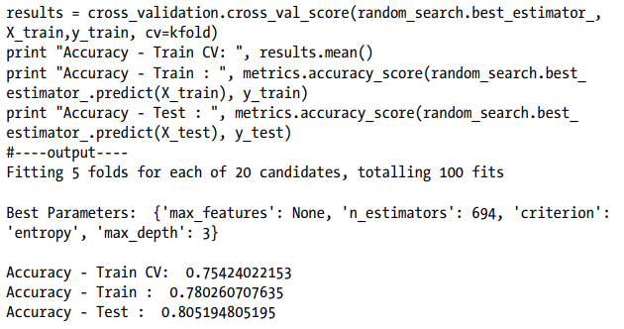

Slide 17
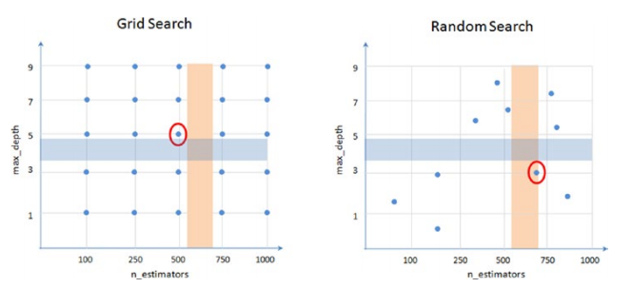
It's worth noting that in this case, we were able to obtain similar accuracy results with 100 fits as we did with 1000 fits with GridSearchCV.Figure 4-16 shows how the effects of grid search vs. random search vary (it's not the real representation) when two parameters are compared. Assume that the best area for max depth is between 3 and 5 (blue shade), and that the best area for n estimators is between 500 and 700. (amber shade). Where the individual regions converge will be the desired equilibrium value for combined parameters. Both methods would be able to find a parameter that is nearly optimal, but not exactly the perfect optimal point.

Slide 18
Endnotes
We learned about various common issues that can impair model accuracy in this process, such as not selecting the best probability cutoff point for class formation, variance, and bias. We also took a quick look at some of the more popular model tuning techniques, such as bagging, boosting, ensemble voting, and hyperparameter tuning with grid search/random search. To keep it simple, we just looked at the most important aspect of each of the above topics to get you started. However, there are more tuning options for each algorithm, and each of these techniques has been rapidly evolving. As a result, I recommend that you keep an eye on their official website and github repository.

Slide 19
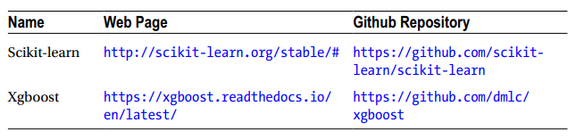
We've completed phase 4, which means you've completed half of your machine learning journey. We'll learn text mining techniques and the basics of the recommender method in the next chapter.

